Slide 1
Refrigerators
The purpose of a refrigerator is to make thermal energy flow from cold to hot. The coefficient of performance for a fridge:
hot reservoir, T_{H}
heat
entropy
work
heat
COP is the largest when T_{H} and T_{C} are close to each other!
Note: Heat can not be transferred from low temperature to high temperature without doing extra work.
cold reservoir, T_{C}

Slide 2
More on Refrigerators
We can create a refrigerator by running a Carnot engine backwards: the gas extracts heat from the cold reservoir and deposit it in the hot reservoir.
hot reservoir, T_{H}
P
1
rejects
heat
heat
2
entropy
T_{H}
work
4
3
heat
T_{C}
absorbs heat
V
However, it is difficult to built a practical refrigerator using such an ideal gas cycles as Carnot or Stirling. Most modern refrigerators use some liquid as a working substance. These schemes are better than a reversed Carnot cycle: much more energy can be absorbed per unit mass of working substance. Thus, the fridge can be much smaller than a Carnot fridge could be.
cold reservoir, T_{C}

Slide 3
The Maximum Efficiency
COP
Real Engine
Question: How a real engine works?
We will not go in-depth of engineering but see few examples only

Slide 4
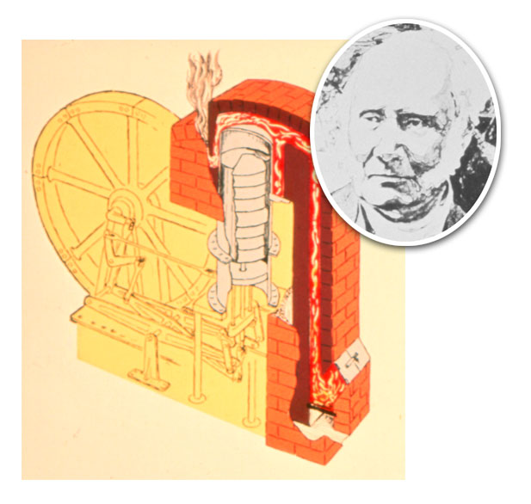
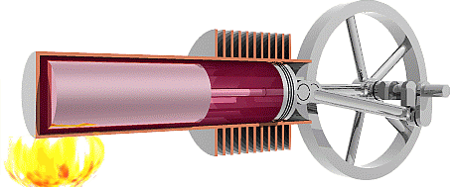
The Stirling heat engine
Stirling engine; a simple, practical heat engine using a gas as working substance.
more practical than Carnot, and its efficiency is close to the Carnot maximum efficiency.
The Stirling engine contains a fixed amount of gas which is transferred back and forth between a "cold" and a "hot" end of a long cylinder.
The "displacer piston" moves the gas between the two ends and the "power piston" changes the internal volume as the gas expands and contracts.
T
2
3
T₂
T₁
4
1
V₁
V₂

Slide 5
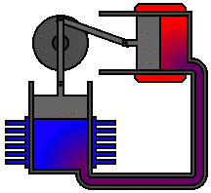
Stirling heat engine
Construction
absorbs heat from an external source, could be anything from gasoline to solar energy to the heat produced by decaying plants.
Working substance is air or any other gas.
Consists of two cylinders with pistons, one in thermal contact with each reservoir.
The pistons are connected to a crankshaft
The gas flows past a regenerator between the two cylinders (a temporary heat sink (cold reservoir), made of wire mesh, whose temperature varies gradually from the hot side to the cold side). The heat capacity of the regenerator is very large, so its temperature is affected very little by the gas flowing past.
The gases used inside a Stirling engine never leave the engine.
Stirling engines are very quiet = there are no exhaust valves that vent high-pressure gases, as in a gasoline or diesel engine, and there are no explosions taking place.
Applications: in submarines or auxiliary power generators, where quiet operation is important.

Slide 6
Internal Combustion Engines (Otto cycle)
Gasoline engine found in most automobiles
Engines where the fuel is burned inside the engine cylinder as opposed to that where the fuel is burned outside the cylinder (e.g., the Stirling engine).
More economical than ideal-gas engines because a small engine can generate a considerable power.
Otto cycle:
Working substance – a mixture of air and vaporized gasoline.
No hot reservoir – thermal energy is produced by burning fuel, resulting in a gas in high T and P.

Slide 7
Otto cycle
3
P
The four-stroke cycle of a conventional gasoline engine.
ignition
expansion
work done by gas
2
compression
work done on gas
4
P_{atm}
0
exhaust
intake/exhaust
1
V₂
V₁
V
0 → 1 intake (fuel + air is pulled into the cylinder by the retreating piston)
1 → 2 isentropic compression
2 → 3 isochoric heating
3 → 4 isentropic expansion producing mechanical work
4 → 1 → 0 the hot exhaust gases are expelled and replaced by a new mixture at
lower T and P
Notes:
The arrows on the piston indicate the direction of its motion during each process. (a) In the intake stroke, air and fuel enter the cylinder. (b) The intake valve is then closed, and the air–fuel mixture is compressed by the piston. (c) The mixture is ignited by the spark plug, with the result that the temperature of the mixture increases at essentially constant volume. (d) In the power stroke, the gas expands against the piston. (e) Finally, the residual gases are expelled, and the cycle repeats.

Slide 8
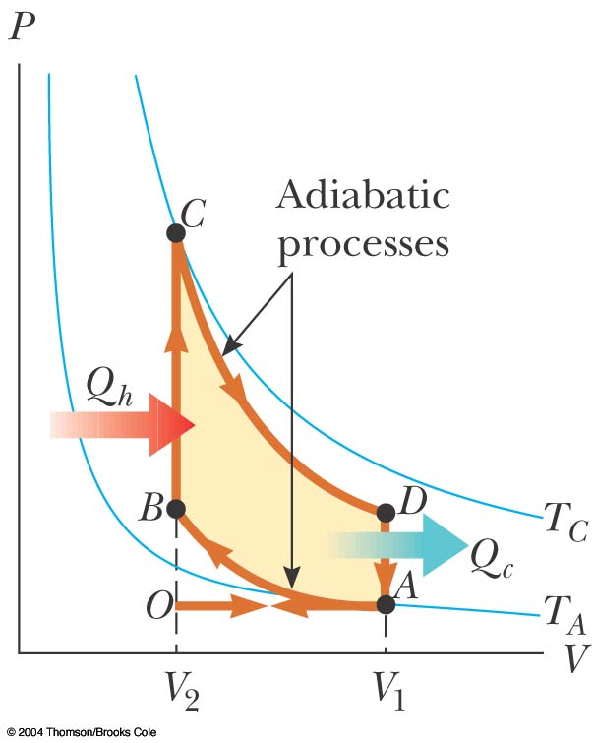
Otto cycle (Cont)
- maximum cylinder volume
- minimum cylinder volume
The efficiency:
- the compression ratio
γ = 1+2/f - the adiabatic exponent
S
3
4
S₁
S₂
2
1
V₂
V₁
V
Notes:
PV diagram for the Otto cycle, which approximately represents the processes occurring in an internal combustion engine.

Slide 9
Otto cycle (cont)
As
$$efficiency=1−{\left(\frac{V_{2}}{V_{1}}\right)}^{γ−1}$$
Typically, compression ration, $\frac{V_{2}}{V_{1}}=8$
➔ Efficiency (max) ~ 56%
While for Carnot cycle with similar temperature $T_{c}\sim 300 K and T_{h}\sim 600 k⇒$ efficiency ~ 66%
Remember $TV^{γ−1}=constant$
Today’s automobile engines’ efficiency ~20-30%
Factors reducing the efficiency:
Friction
Conductive heat loss
Incomplete combustion of the fuel
The way to improve the efficiency?
Increase compression ratio
But higher compression
➔ higher temperature increase
Gasoline can pre-ignite spontaneously before
compression is complete (before ignition stage)
Cause P to increase before point 2
(or B) on PV-diagram
This can be avoided in diesel engine
by compressing only air and then spraying fuel into the cylinder (where air is hot enough)
➔ Ignition starts

Slide 10
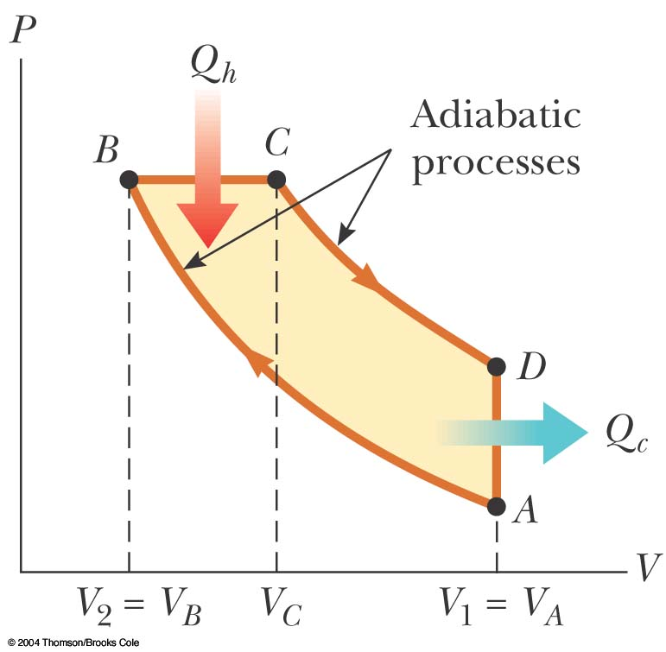
Ideal Diesel Cycle
Diesel engine generates higher compression ration, typically ~20
ignition
Efficiency ~ 40%
Actual efficiency formula is complicated in terms of $\frac{V_{1}}{V_{2}}\&\frac{V_{3}}{V_{2}}$
expansion
compression
Problem 4:20 Start with
$$e =1−\frac{Q_{c}}{Q_{h}}$$
Find $Q_{h} and Q_{c}$
Remember $∆U=Q−PdV$
exhaust
= V₃
= V₄
$\frac{V_{3}}{V_{2}}$ is called cut off
Only limit on efficiency is melting temperature of the material and strength to higher pressure
Problem?
Ceramic engine could withstand to higher temp and pressure
➔ Better efficiency
Notes:
Figure 22.14 PV diagram for an ideal diesel engine.
Air undergoes adiabatic compression from A to B; at B, fuel is injected into the cylinder, mixes with the hot air and results in combustion, the fuel then undergoes constant pressure expansion from B to C; At C the fuel injection is cut off and the gas expands through an adiabatic process; the exhaust valve is opened and a constant volume output of energy occurs as the cylinder empties.

Slide 11
Steam engine (Rankine cycle)
Sadi Carnot
An idealized PV-diagram of a steam engine cycle is called Rankine cycle
hot reservoir, T_{H}
P
Boiler
processes
at P = const,
δ Q = dH
Boiler
water
3
heat
2
Turbine
Pump
W
Pump
Turbine
Adiabatic expansion
1
Water + steam
steam
4
Condenser
condenser
V
1→2 Starting at 1 (water pump) – water is pumped to
higher pressure
2→3 Water flows into Boiler, where it is heated at
constant pressure (It becomes steam)
3→4 Steam hits the turbine – expands Adiabatically
(do useful work) and cools down and ends up
original lower pressure (becomes mixture of water and steam)
4→1 Finally, this partially condensed fluid is cooled in
condenser (it becomes water at constant pressure)
cold reservoir, T_{C}
Notes:
1-2 water is pumped to high pressure (2) and then flows into a boiler, where (step 2-3) heat is added at constant pressure. At point 3, the steam hits the turbine, where is expands adiabatically, cools, and ends up at the original low pressure (4). The partially condensed fluid is cooled further in a condenser (a network of pipes in good thermal contact with the low-temperature reservoir.

Slide 12
Rankine cycle (cont)
Efficiency can not be calculated from PV-diagram
Because of phase change involved
We must consider Enthalpy
Efficiency, $e=1−\frac{Q_{c}}{Q_{h}}$
$$H=U+PV$$
In this case,
$$Q_{h}=U_{h}+{\left(PV\right)}_{h}$$
Since heat is absorbed and expelled at constant P, while phase changes in both stages
P
Boiler
$$Q_{c}=U_{c}+{\left(PV\right)}_{c}$$
water
Q_{h}
3
2
$$Q_{h}=H_{3}−H_{2}$$
& $Q_{c}=H_{4}−H_{1}$
Pump
Turbine
Adiabatic expansion
➔ $e=1−\frac{H_{4}−H_{1}}{H_{3}−H_{2}}$
Q_{c}
A pretty good assumptions is
1
steam
$$H_{2}≈H_{1}$$
Water + steam
4
Since at both stages, the phase is liquid
V
$$e=1−\frac{H_{4}−H_{1}}{H_{3}−H_{1}}$$
condenser
Table 4.1 &4.2, page 136
Applications: Large power plants
The steam does work by pushing a turbine,
The heat is provided by burning a fossil fuel or fissioning uranium.

Slide 13
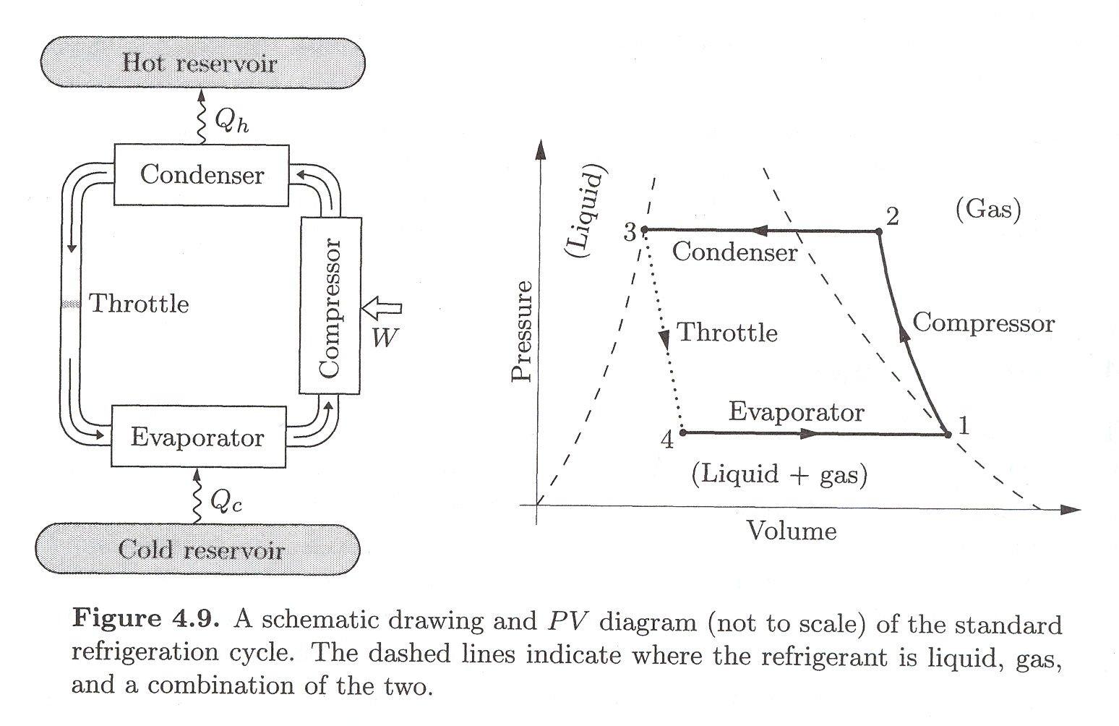
Real Refrigerators/Air Conditioners
Standard refrigeration cycle – reverse Rankine cycle
Again the working substance changes back and forth from a gas to liquid
But the fluid must have a much lower boiling temperature

Slide 14
Cooling of Gases
In a refrigerated, we need to cool the gas (cooling fluid) below cold reservoir temperature
The process is called Throttling Process (also known as Joule-Thomson Process
V_{f}
T_{f}
Fluid is pushed through a piston, exerting pressure P_{i} in volume V_{i}
Second piston (moving to right) exerts backward pressure P_{f} in a volume V_{f}
This is adiabatic process – so no heat flows
P_{i}
V_{i}
T_{i}
P_{f}
0
$$∆U=U_{f}−U_{i}=Q+W$$
But $W=P_{i}V_{i}−P_{f}V_{f}$
$$U_{f}−U_{i}=P_{i}V_{i}−P_{f}V_{f}$$
$$U_{i}{+P}_{i}V_{i}=U_{f}+P_{f}V_{f}$$
$$H_{i}=H_{f}$$
Enthalpy is constant in Throttling process
For an ideal gas, this process won’t result in any T change:
H = const means T = const
for an ideal gas
Thus, we cannot cool an ideal gas by going through the Joule-Thomson process! (Similar to expansion of an ideal gas through a hole in vacuum).
Luckily, for real gases, the temperature does change in the Joule-Thomson process.

Slide 15
Due to forces between particles
For ideal gas
$$H=U_{kinetic}+PV$$
For dense gas or liquid
$$H=U_{kinetic}+U_{potental}+PV$$
Forces between particles are weakly attractive at long distance but are strongly repulsive when particles are very close to each other and hence $U_{potentail}$ can be negative for under certain conditions.
$U_{potential}$ in this case changes from more negative to less negative (increases)
If $U_{potential }$increases, $U_{kinetic}$ decreases ➔ fluid cools down
Reading Assignment:
Liquification of gases, towards absolute zero (including laser cooling)
(P. 141 – 147)

Slide 16
Toward Absolute Zero
10⁹
Center of hottest stars
Center of Sun,
nuclear reactions
10⁷
10⁵
Electronic/chemical energy
Surface of Sun, hottest boiling points
10³
Temperature, K
Organic life
Liquid air
10¹
Liquid ⁴He
Electronic
magnetism
Universe
Superfluid ⁴He
10⁻¹
Superconductivity
10⁻³
Superfluid ³He
Nuclear
magnetism
10⁻⁵
Lowest T of condensed matter

Slide 17
Assignment # 6 Due 3/25/2022
4.5, 4.6, 4.14, 4.15 & 4.23.
Problems for practice of Ch 4:
4.1, 4.2, 4.3, 4.4, 4.7, 4.8, 4.9, 4.10, 4.11, 4.18, 4.20 & 4.22.

